Slide 1
FastQC report
How to understand and interpret it

Slide 2
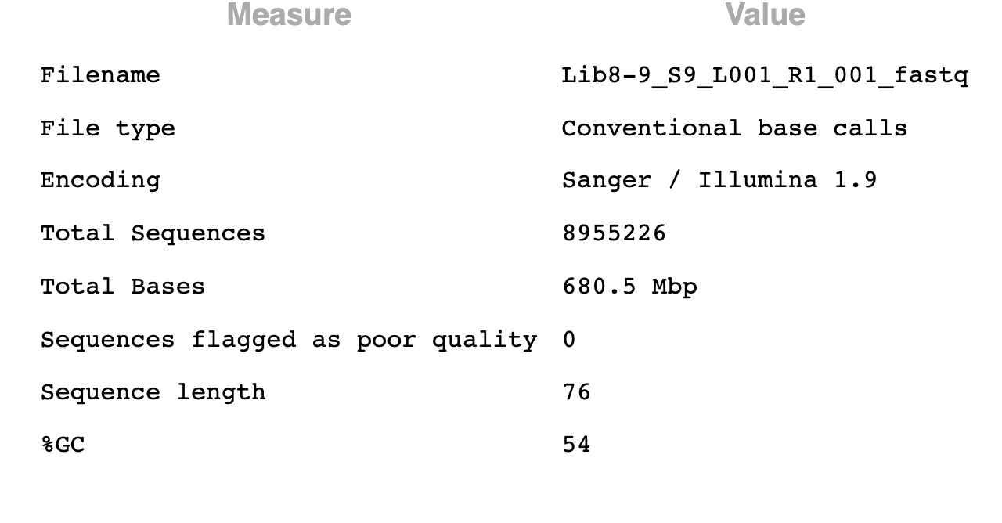
Basic statistics
Displays the basic information of the RNA-Seq data set (e.g., encoding, total number of sequences, etc.)

Slide 3
Basic statistics
If all sequences are of the same length, then only one value will be indicated in “Sequence length”
Otherwise (i.e., if the sequences have various lengths), the lengths of the shortest and longest sequences will be indicated in “Sequence length”

Slide 4
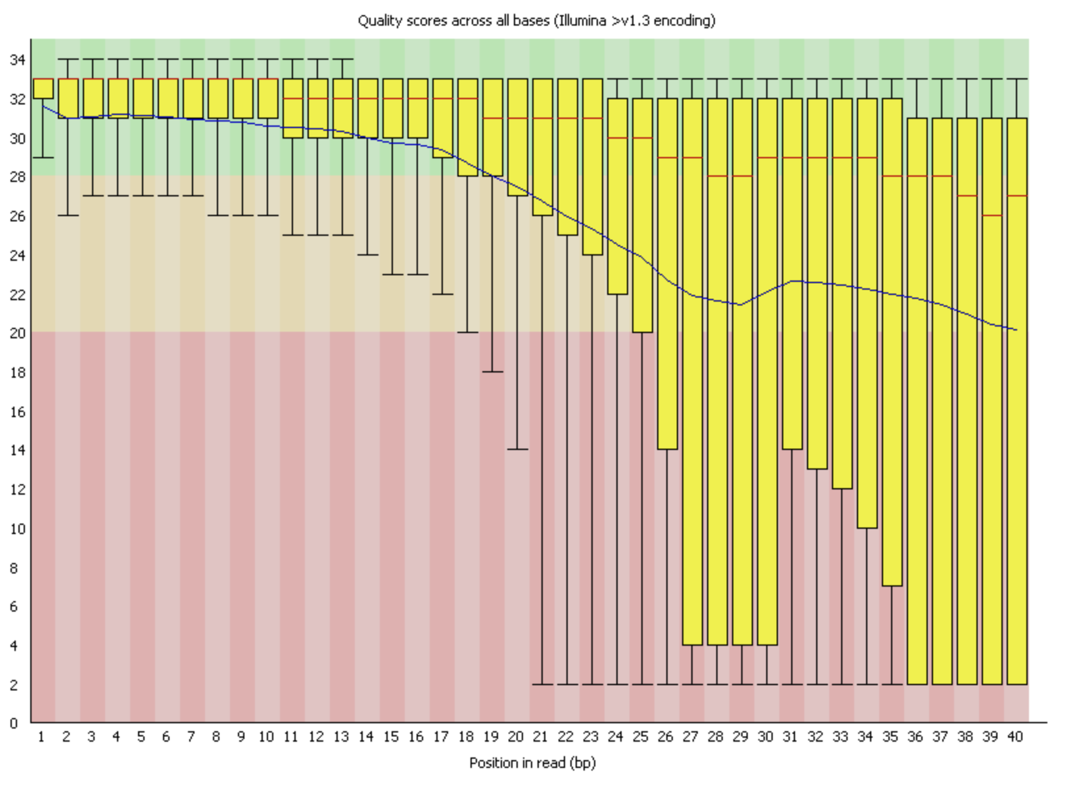
Per base sequence quality
Y-axis indicates quality scores
X-axis indicates the position in the read
Example from the Babraham Bioinformatics website

Slide 5
Per base sequence quality
Box-and-whisker plot
The upper part of the yellow box is the 3rd quartile (第３四分位数）
The red line in the middle of the yellow box is the median (中央値)
The bottom part of the yellow box is the 1st quartile (第１四分位数）
The blue line is the mean (平均)
Example from the Babraham Bioinformatics website

Slide 6
Per base sequence quality
In this example, we can see that the mean quality score tends to be high in the left part of the reads.
However, the mean quality score tends to decrease as we go to the right part of the reads.
Example from the Babraham Bioinformatics website

Slide 7
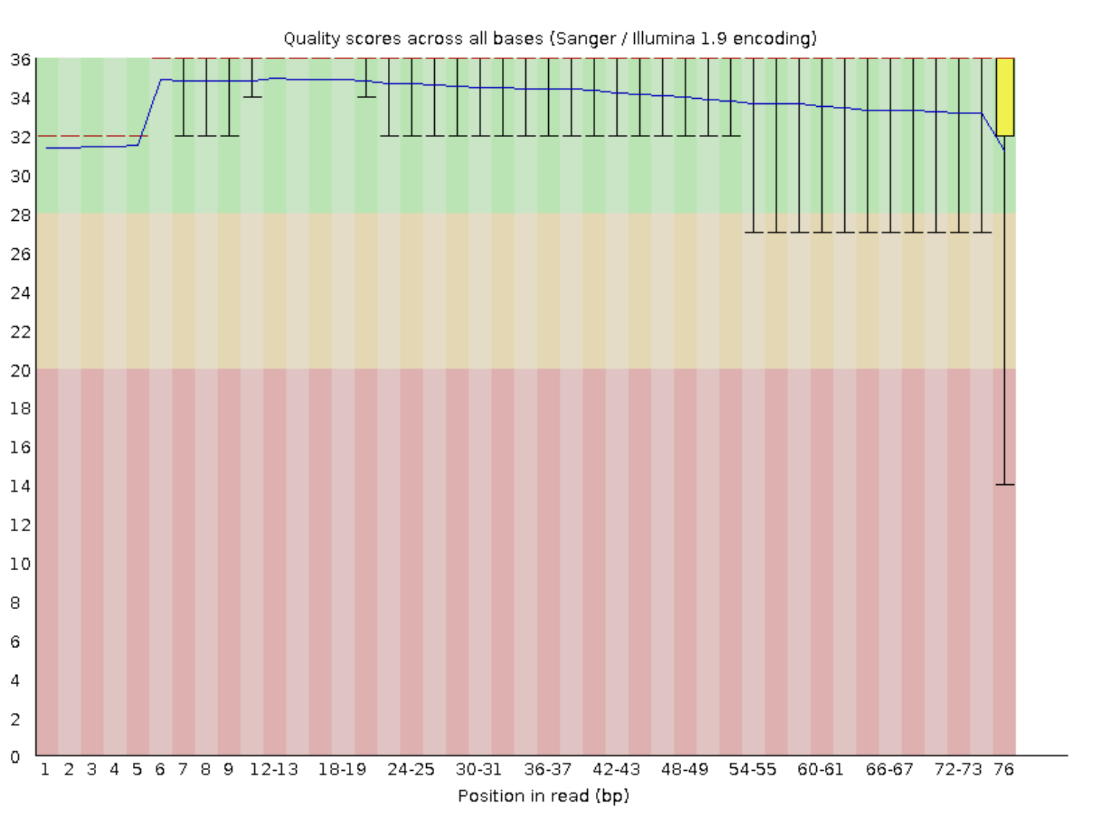
Per base sequence quality
Let’s look at the example in the PDF file
We can see that the mean quality score (blue line) is consistently high (within the green area)
Why does this graph NOT have yellow boxes except for the rightmost area? Because the quality scores are so consistently high that FastQC cannot meaningfully define the 1st and 3rd quartiles.
This is good news!
Example from the PDF file

Slide 8
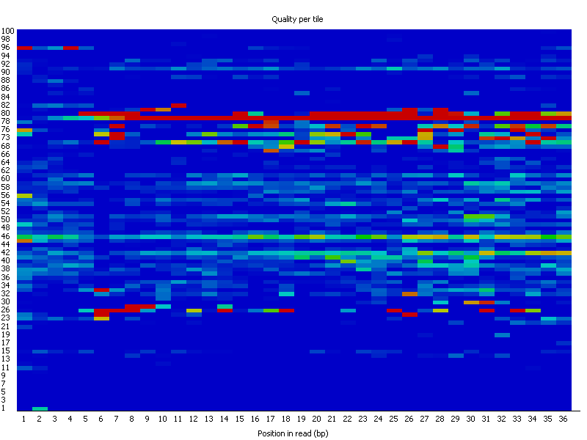
Per tile sequence quality
This graph shows the mean quality score for each flowcell tile
The Y-axis indicates the flowcell tile
The X-axis indicates the position in the read
Example from the Babraham Bioinformatics website

Slide 9
Per tile sequence quality
The color indicates the mean quality score.
Red means low quality score, and blue mean high quality score.
In this example, we can see that the reads in flowcell tiles 78 ~ 80 tend to have low quality (many red areas)
Example from the Babraham Bioinformatics website

Slide 10
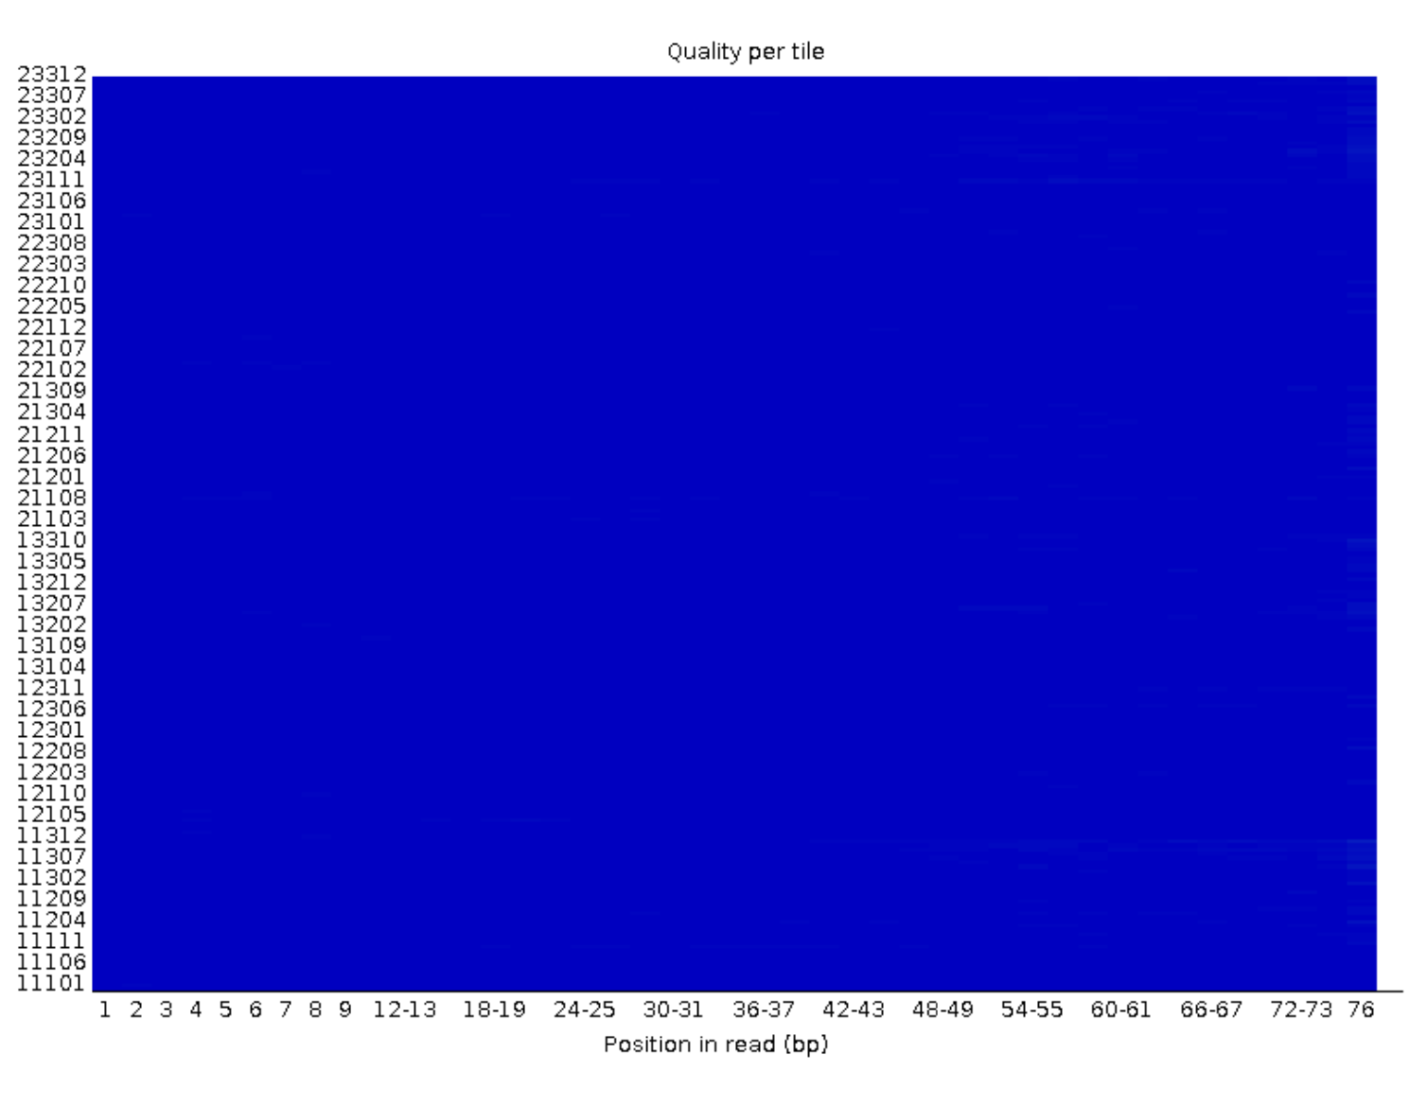
Per tile sequence quality
Let’s look at the per tile sequence quality graph in the PDF file
In this graph, everything is blue
This is good news, because blue indicates high quality.
Example from the PDF file

Slide 11
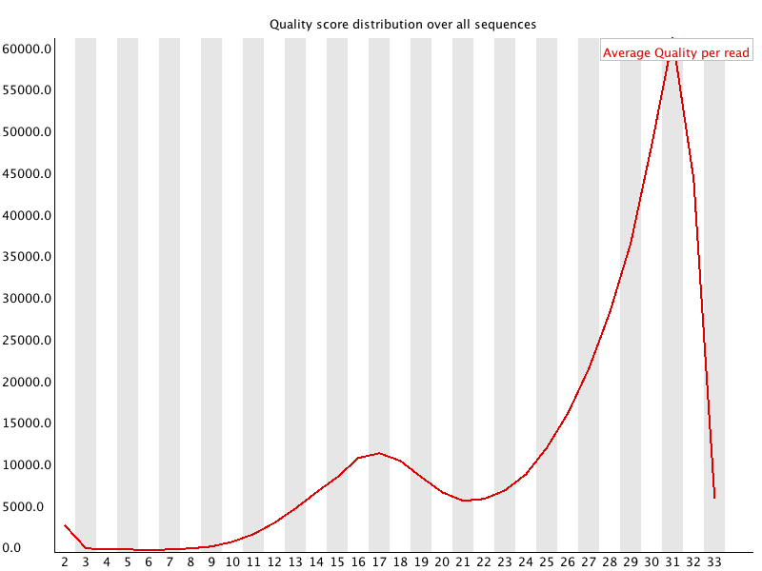
Per sequence quality scores
The X-axis indicates average quality scores
The Y-axis indicates the number of sequences
The red line indicates how many sequences (Y-axis) have a certain average quality score (X-axis)
Example from the Babraham Bioinformatics website

Slide 12
Per sequence quality scores
In this example, we can see that many sequences have an average score of 30~32 (blue circle)
We can also see that there are a small number of reads with very low average quality score (green circle)
Having a small number of such low-quality sequences is OK.
However, if the number of such sequences is large, then there is probably a problem with the experiment.
Example from the Babraham Bioinformatics website

Slide 13
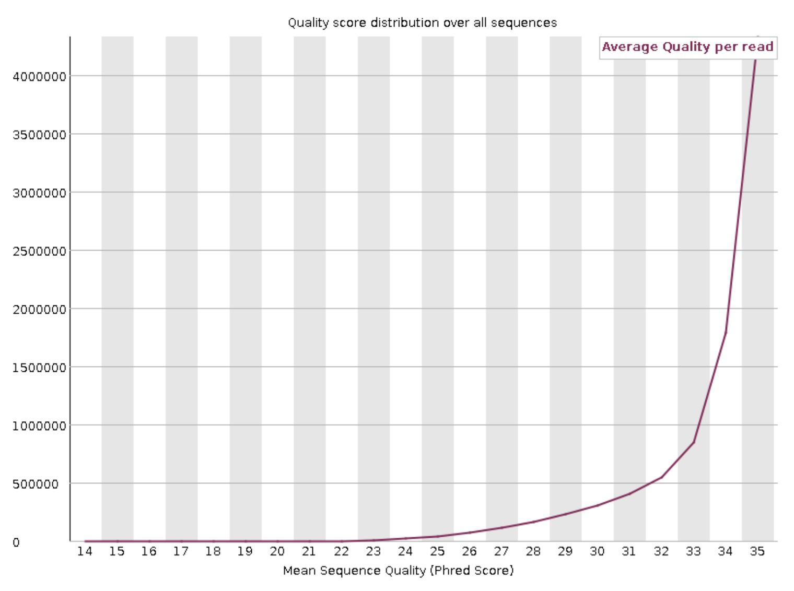
Per sequence quality scores
Let’s look at the per sequence quality scores graph of the PDF file
We can see that there are practically no sequences with low average quality.
Almost all sequences have high quality.
This is good news!
Example from the PDF file

Slide 14
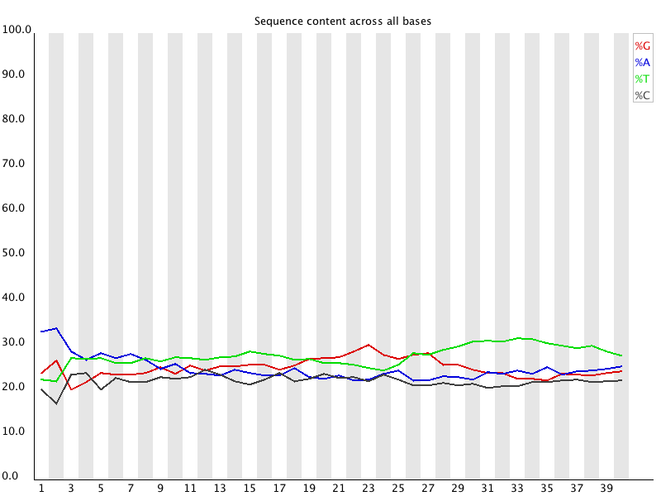
Per base sequence content
The X-axis represents the position in the read
The Y-axis represents the percent in that position
The colored lines indicate the percent of each base in that position
Example from the Babraham Bioinformatics website

Slide 15
Per base sequence content
It is normal to have sudden, sharp changes at the left part of the read (red circle)
Example from the Babraham Bioinformatics website

Slide 16
Per base sequence content
In the middle and right part of the read, there are usually no sharp, sudden changes. Hence, the lines appear approximately parallel (red circle)
Example from the Babraham Bioinformatics website

Slide 17
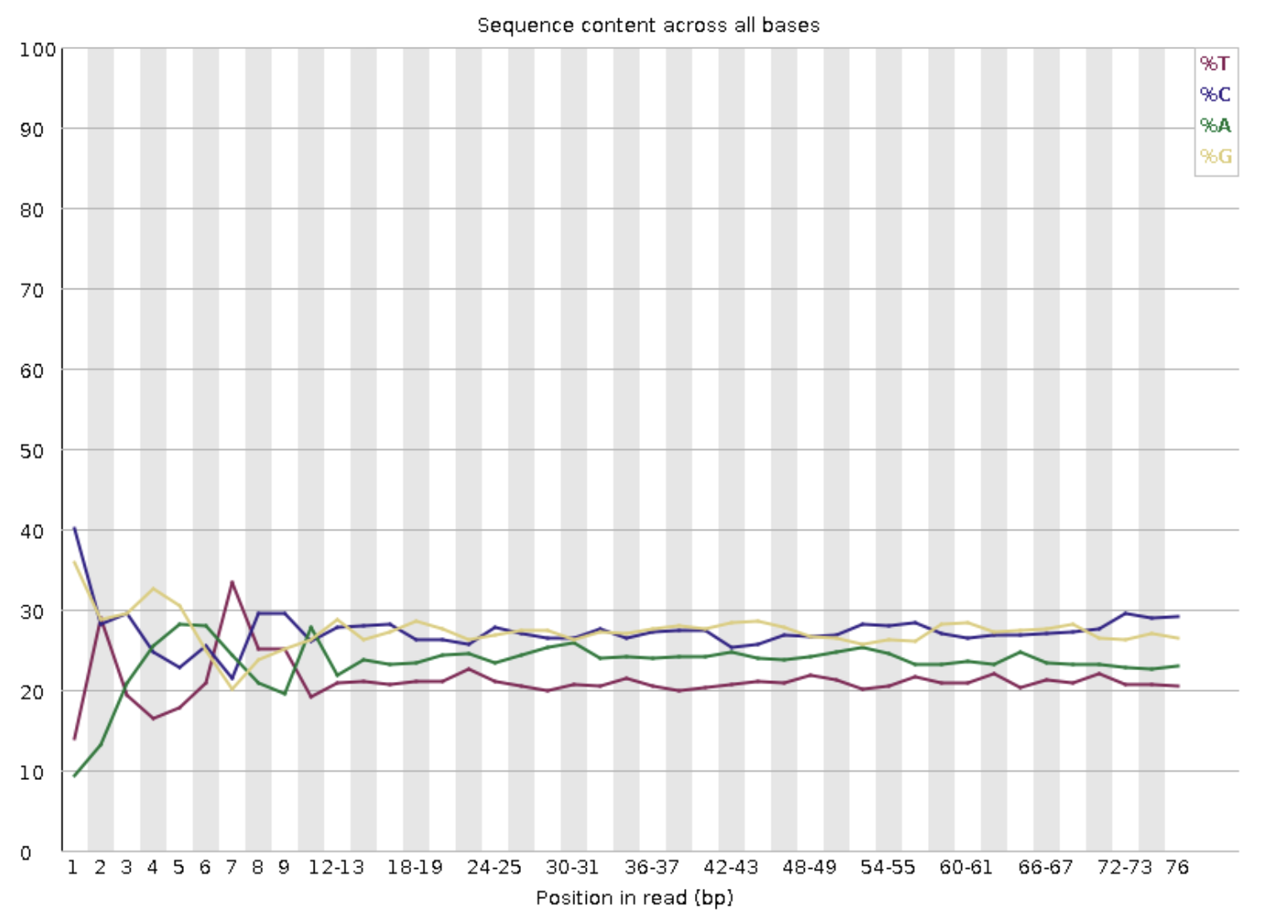
Per base sequence content
Let’s look at the per base sequence content graph from the PDF file
Example from the PDF file

Slide 18
Per base sequence content
The left part of the reads have sudden, sharp changes in the percentage of the four bases.
Example from the PDF file

Slide 19
Per base sequence content
In the middle and right part of the reads, the lines are approximately parallel (no sudden, sharp changes)
Example from the PDF file

Slide 20
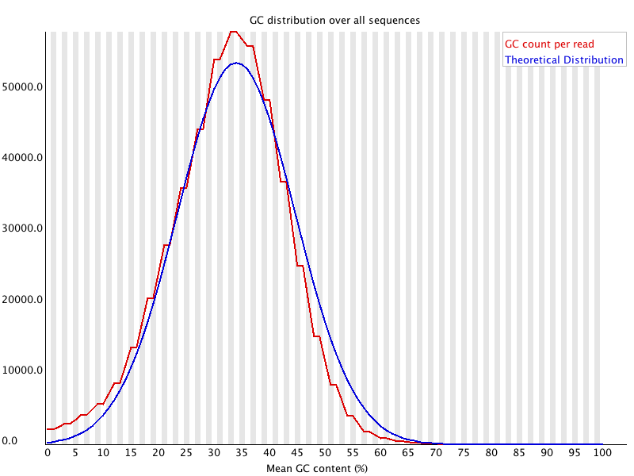
Per sequence GC content
The X-axis indicates the mean GC (Guanine-Cytosine) content
The Y-axis indicates the number of sequences having a particular mean GC content
The red line represents the mean GC content of the data set that we analyzed.
The blue line represents the theoretical (ideal) distribution of mean GC reads
Example from the Babraham Bioinformatics website

Slide 21
Per sequence GC content
Theoretically, the mean GC content should follow a normal distribution
As we can see, the actual GC cotent distrubtion (red line) is similar to the theoretical distribution (blue line).
Example from the Babraham Bioinformatics website

Slide 22
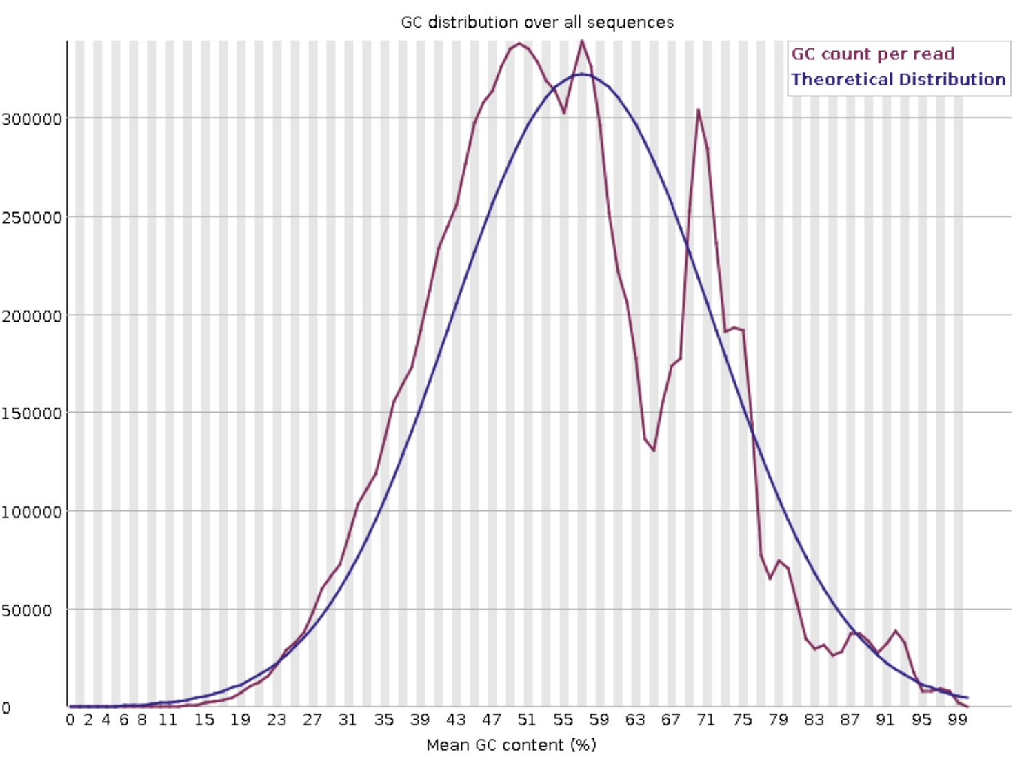
Per sequence GC content
Let’s look at the per sequence GC content in the PDF file
As we can see, the GC content distribution of the actual data is similar to the theoretical distribution (except for the middle part)
This GC content distribution is OK
Example from the PDF file

Slide 23
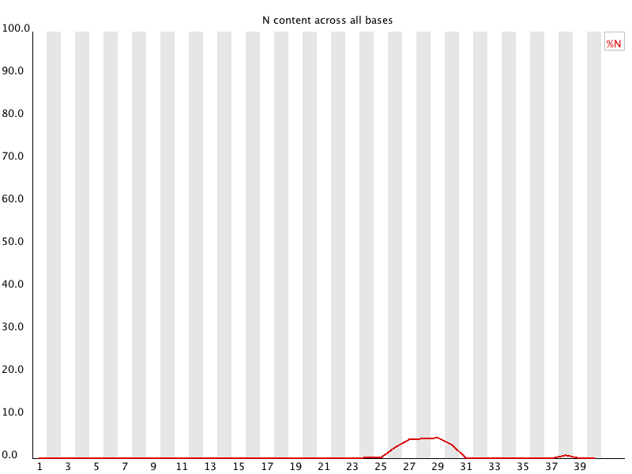
Per base N content
If a sequencing machine is unable to confidently identify a particular base, it is indicated as “N” (instead of “A”, “T”, “C”, or “G”).
X-axis indicates the position in the read
Y-axis indicates the percent of N bases at that position
Example from the Babraham Informatics website

Slide 24
Per base N content
It is normal to have a small percentage of N
However, if the percentage of N is high, then that could indicate a problem (because it means that there were many bases that could not be identified with confidence)
Example from the Babraham Informatics website

Slide 25
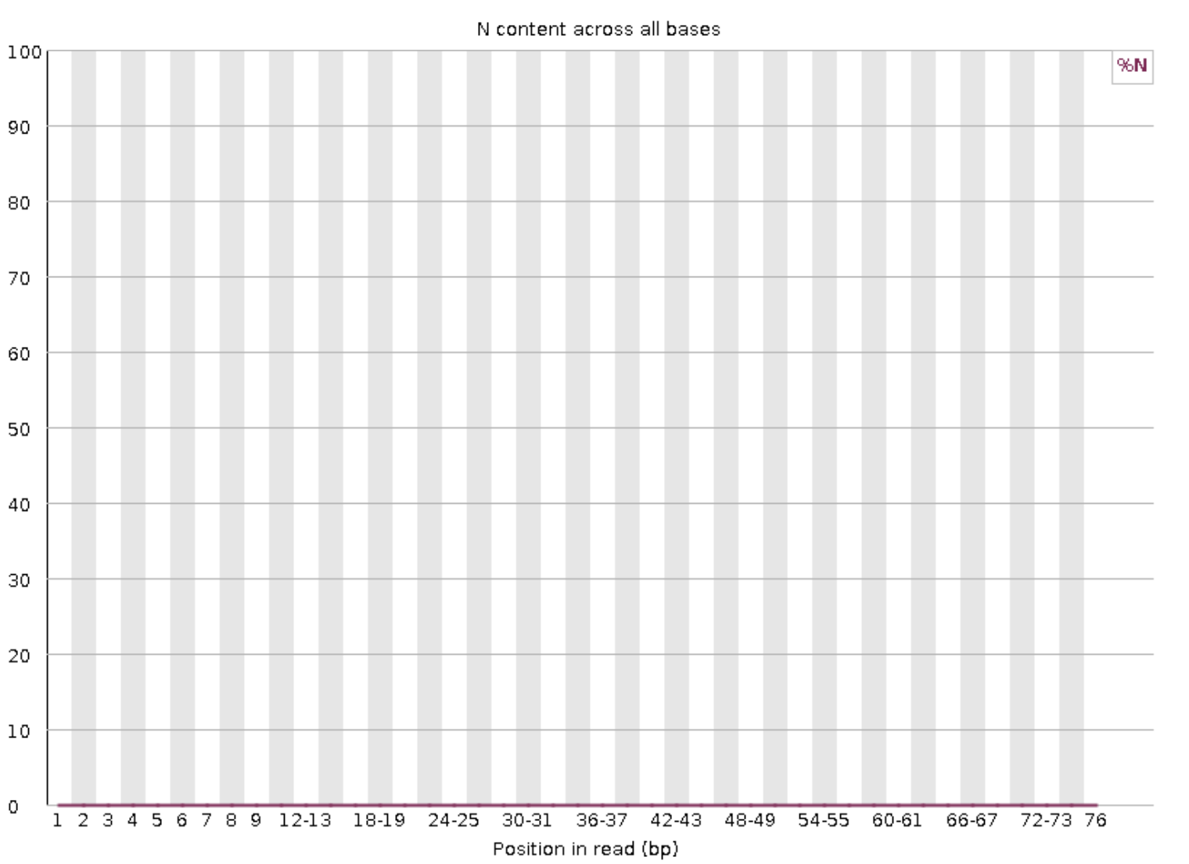
Per base N content
Let’s look at the per base N content of graph in the PDF file
The N content is practically zero
This is good news!
Example from the PDF file

Slide 26
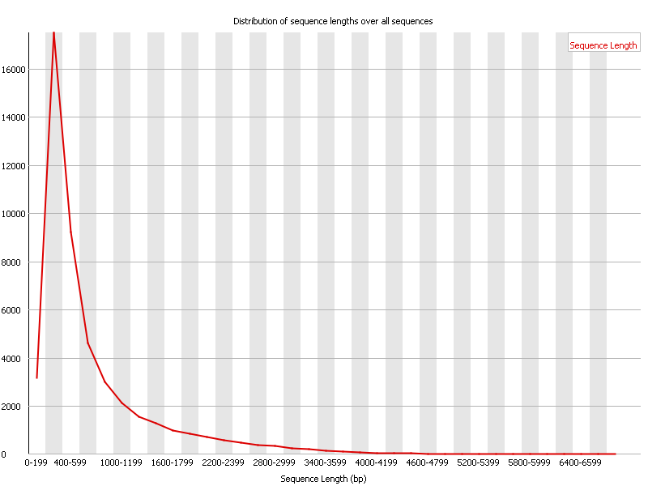
Sequence length distribution
Some sequencers produce sequences of uniform lengths.
However, there are also some sequences that produce sequences of various lengths.
This graph shows the distribution of sequence lengths.
The X-axis indicates sequence length.
The Y-axis indicates the number of sequences having that particular length
In this case, the sequencer produced sequences of various lengths
Example from the Babraham Bioinformatics website

Slide 27
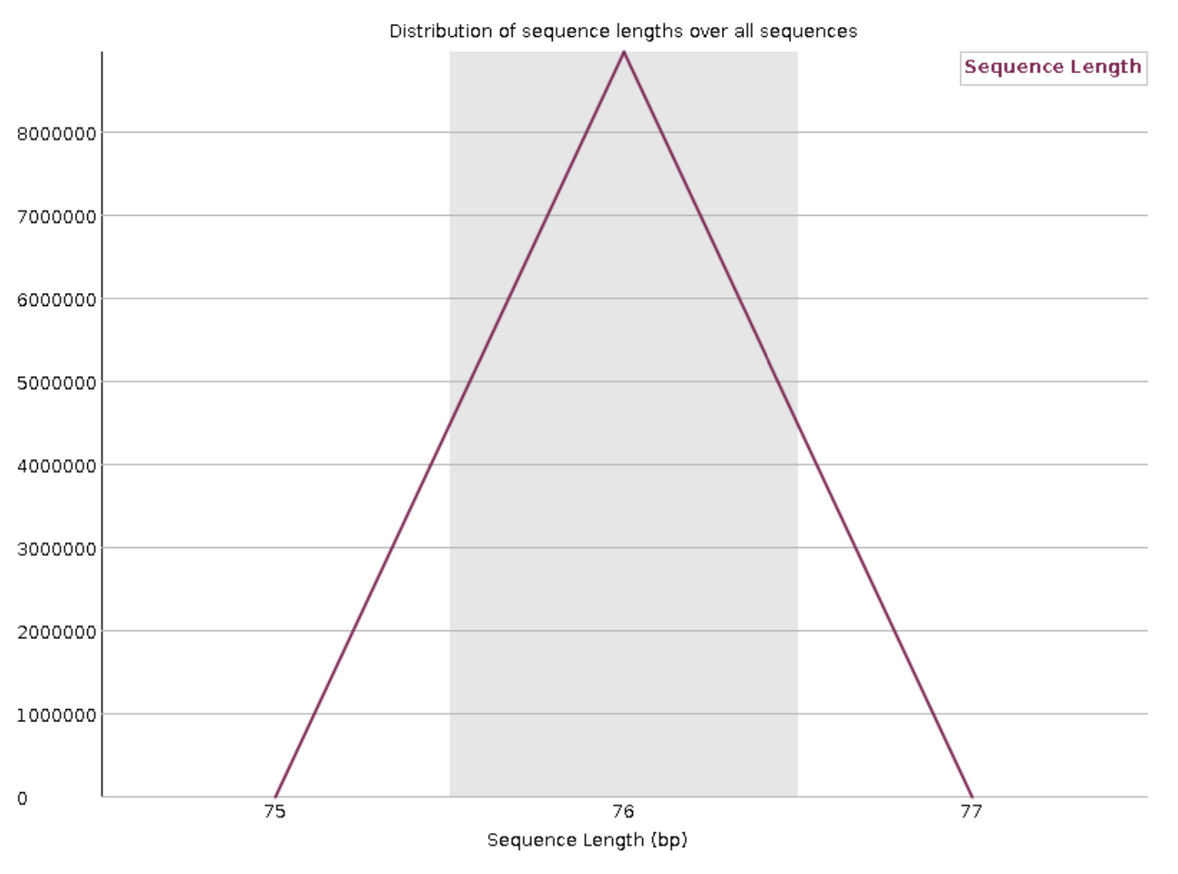
Sequence length distribution
Let’s look at the example in the PDF file
All reads have length 76
In this graph, the sequences are of uniform length (unlike the previous graph)
Example from the PDF file

Slide 28
Basic statistics
Do you remember this slide?
As you can see, the sequence length is indicated as “76” in the basic statistics.
This means all sequences are of the same length.
If the sequences were of different lengths, then the sequence length will be indicated as a range of values (from the minimum length to the maximum length)

Slide 29
Sequence length distribution
Therefore, this graph is consistent with the sequence length indicated in the basic statistics
Example from the PDF file

Slide 30
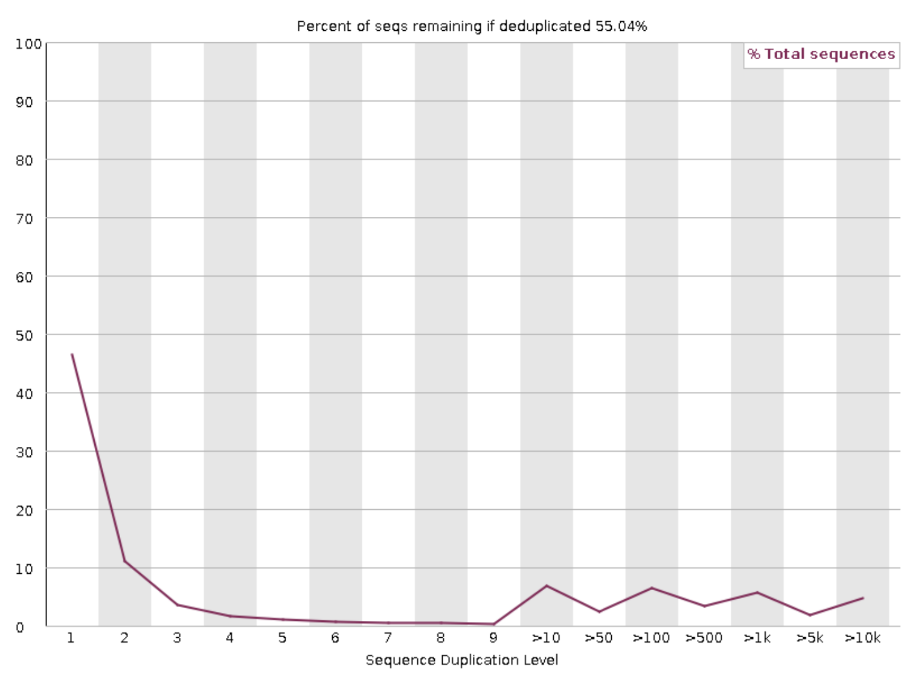
Sequence duplication levels
Most sequences will occur only once, without any other sequences that are identical to it (i.e., no duplication).
However, in some cases, sequences can be duplicated
If the level of sequencing coverage is very high, then duplication may occur
Another possible cause of duplication is enrichment bias (e.g., PCR over-amplification).
Example from the PDF file

Slide 31
Sequence duplication levels
The X-axis indicates duplication level
The Y-axis indicates the percentage of sequences
This graph shows the percent of sequences that belong to each duplication level.
The number at the top of the graph (red circle) indicates the percent of sequences that would remain in the duplicates were removed
Example from the PDF file

Slide 32
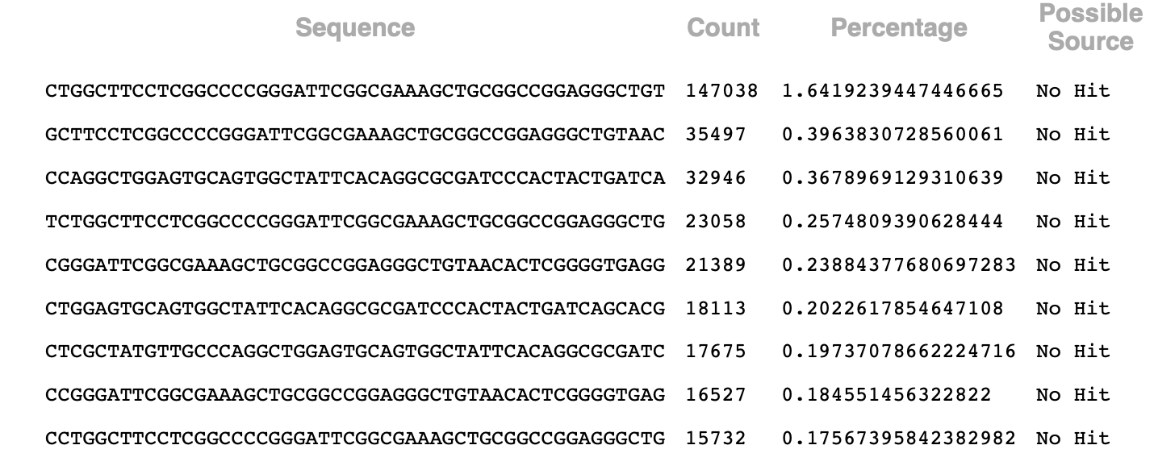
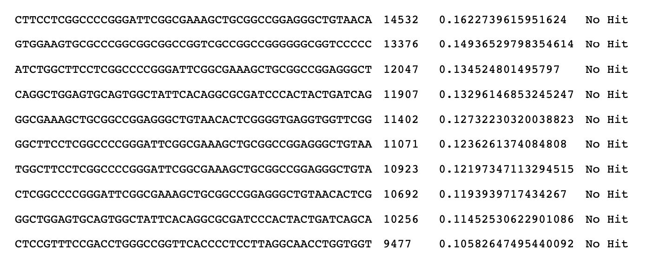
Overrepresented sequences
Shows the list of sequences that are overrepresented in the data set
Shows the count and percentage of the overrepresented.
Also shows the possible source of the overrepresented sequences (e.g., known contaminants).
For the “possible source”, the program searches a database of known contaminants and checks if there is a contaminant which matches the overrepresented sequence
In this data set, there are no known contaminants which match the overrepresented sequences
Example from the PDF file

Slide 33
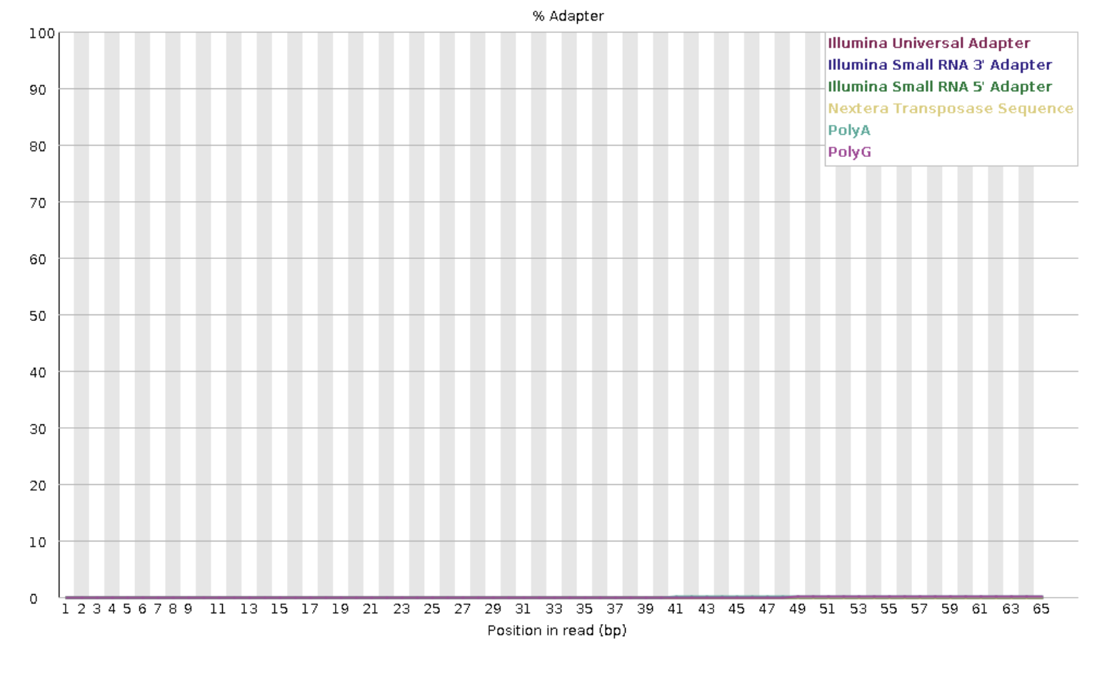
Adapter content
The program checks the sequencing data for the presence of known adapters
In this graph, the adapter content is zero for all the known adapters listed in the graph
Therefore, we don’t have to worry about the presence of such adapters in this data set
Example from the PDF file

